Slide 1
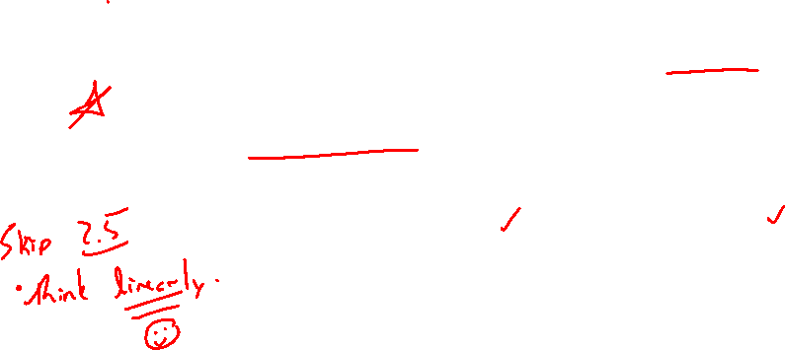
Section 2.6 Transformations of Functions
Lecture 1
Motivation and y-Transformations
Notes:
Note, skip 2.5, more on lines, focus is on thinking linear. Similar ideas to previous lectures

Slide 2

Section 2.6 Homework Submission to Canvas
Preview of section
Skim the section in text and write a short paragraph summary.
Give a bulleted list of all important definitions, theorems, and formulas without details.
Notes on video lectures
Take notes on everything written on slides including all details, worked examples, on-own activities, as well as your own thoughts and questions.
Try on-own activities first, then write down provided solution next to it for comparison.
Worked examples from the text
Write down the problem and attempt without looking at the solution.
Use the solution to write the best explanation you can.
Solutions to textbook exercises
Model approaches and explanations given in the video lectures and textbook examples.
Final reflection of section
List the key takeaways to remember as a bulleted list.

Slide 3
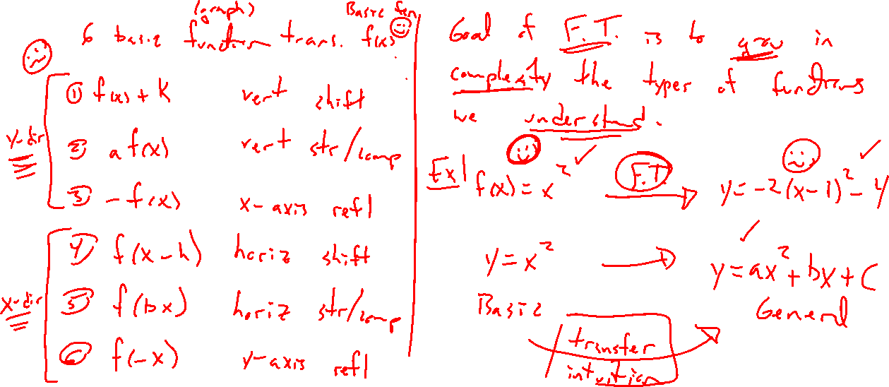
Transformation List, Why Bother?
Notes:
List of 6 transformations and general combination.
Why bother? Can go from a basic function (y=x^2) to very complex transformation (y=-2(x-3)^2+10)
Grow tremendously the number of functions we can graph and understand.
Study each individually to gain intuition. Combine to understand complexity.

Slide 4
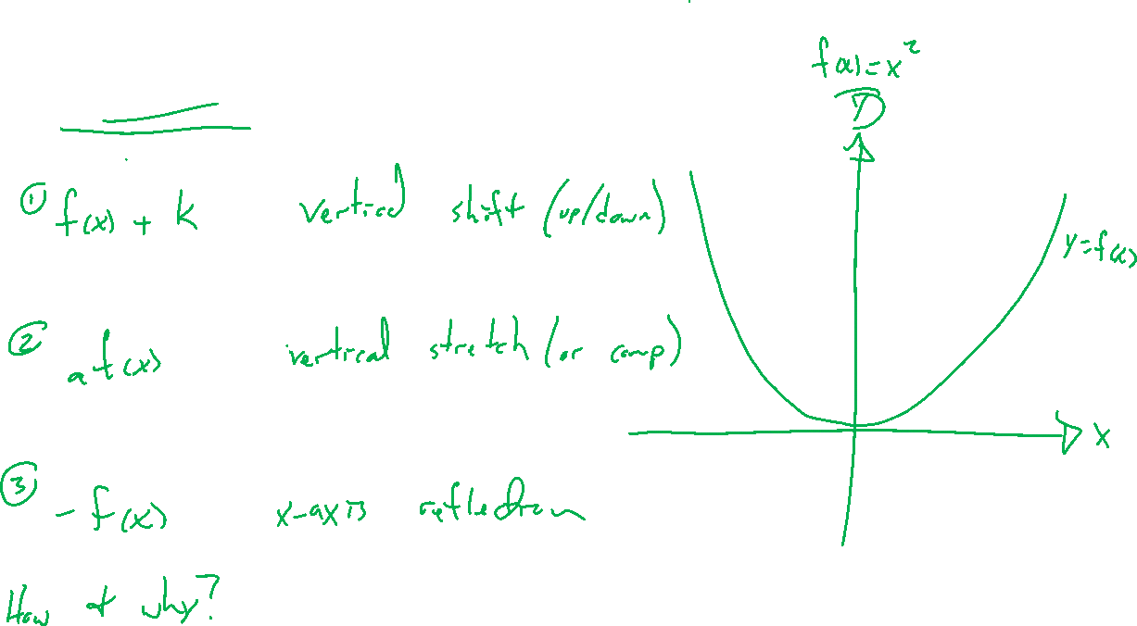
Y-Direction Transformations
Notes:
Y=f(x)+k
Y = af(x)
Y = -f(x)
Combinations, y=-af(x)+k

Slide 5
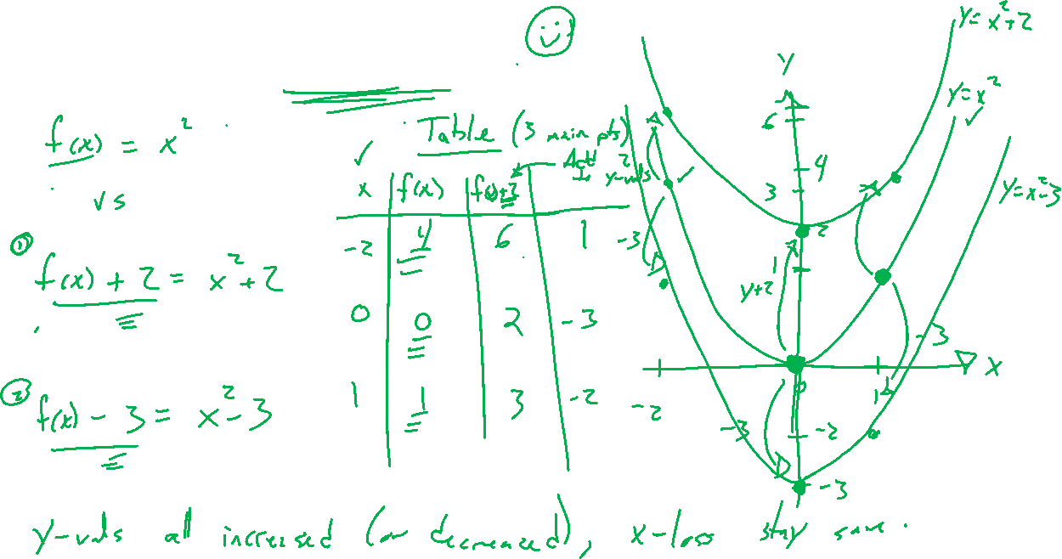
Example: Vertical Shift
Notes:
F(x)+k, how is the output of f changed? Note, output changes, input location does not.
Y=f(x)=x^2
F(x)+2, -3
Use Desmos tables. Draw +2 carefully on slide. Keep track of three points moving.
This balance of formula, table, graph is what grows your intuition in this class, rich diversity of perspective.

Slide 6
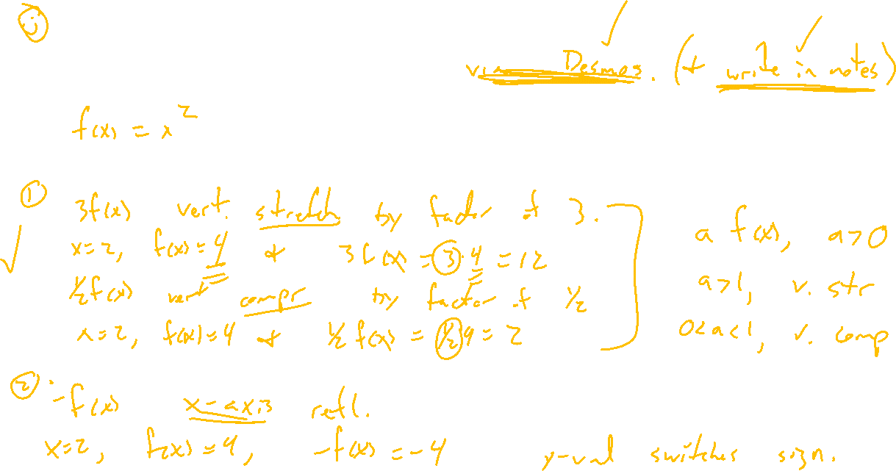
Example: Try on Own
Notes:
Remaining 2, af(x), -f(x)
Try in Desmos for various choices. Explain what happens.
Y multiplied (vertical stretch). Y flipped in sign (x-axis reflection)

Slide 7
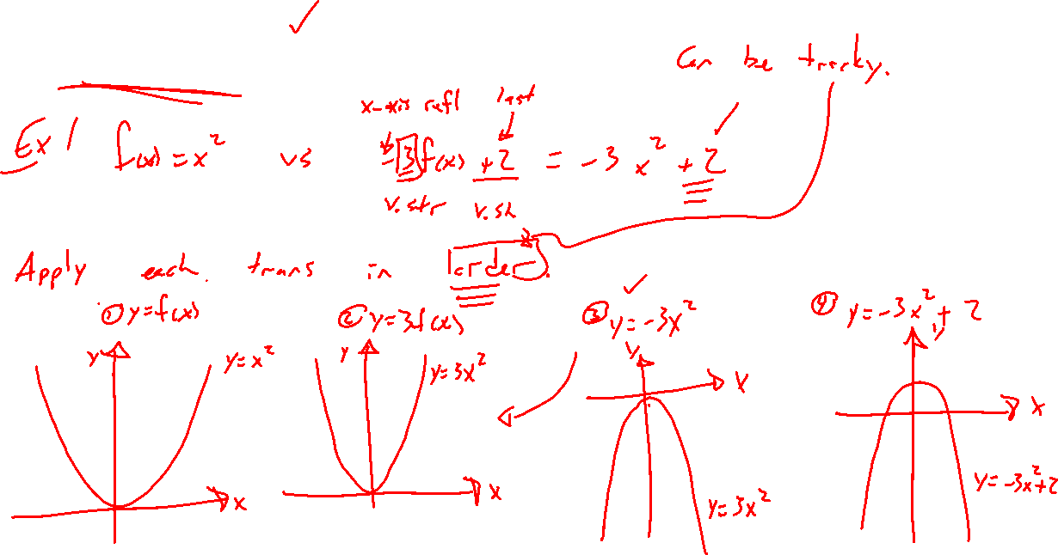
Combining Y-Transformations
Notes:
Example: Knowing the graph of y=x^2, graph instead y=-3x^2+2.
Break into 3 steps. Order of steps matters. Track three main points. Show how to check in end.
X^2, 3x^2, -3x^2, -3x^2+2
Note, vertical shifting first is trouble with the x-axis reflection.

